Slide 1
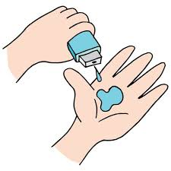
Project Title: Seasonal Agriculture Performance Student Name: Chatakonda Ganesh College Name: G. Pullaiah College of engineering and Technology
AICTE STU ID : STU6582ca5414ca81703070292

Slide 2

PROBLEM STATEMENT
Agricultural activities are influenced by seasonal variations in environmental conditions, farming practices, resource availability and market conditions. As a result, agricultural performance may differ from one season to another.
The problem is to analyze the given agricultural dataset and investigate seasonal differences in agricultural performance by identifying meaningful patterns, trends, relationships and variations within the available data.
However, raw agricultural data does not clearly explain how agricultural performance changes across seasons or what patterns can be observed in different seasonal conditions.

Slide 3
Project Description
The Seasonal Agriculture Performance Analysis project evaluates how agricultural outcomes—such as crop yield, water usage, and financial profitability—fluctuate across the three major Indian cropping seasons: Kharif, Rabi, and Zaid. Using a comprehensive dataset of 4,000 farm records spanning multiple states, crops, and environmental conditions, this project provides a data-driven framework to understand seasonal variations and support evidence-based agricultural decision-making.keep this below in who are the end users Policy Makers & Government Officers: Plan seasonal water allocation, crop subsidies, and regional agricultural strategies.

Slide 4

WHO ARE THE END USERS? Policy Makers & Government Officers: Plan seasonal water allocation, crop subsidies, and regional agricultural strategies. Farmers & Extension Workers: Optimize seasonal crop choices, improve water-use efficiency, and manage pest/financial risks. Agri-Tech & Financial Institutions: Assess seasonal credit or crop insurance risks and build tailored farming tools. Data Analysts & Researchers: Model seasonal yield patterns and study agricultural economics.

Slide 5

Technology Used Python: Core programming language used for data processing, statistical analysis, and scripting. Pandas: Used for data manipulation, cleaning, missing value imputation, and seasonal aggregations. NumPy: Used for numerical operations and array handling. Matplotlib & Seaborn: Used for generating data visualizations, such as bar charts, correlation heatmaps, and distribution plots. SciPy (scipy.stats): Used for statistical hypothesis testing, specifically running one-way Analysis of Variance (ANOVA). nbformat & pathlib: Used for programmatic generation and structuring of Jupyter Notebook (.ipynb) files. Google Colab: The cloud-based Jupyter Notebook environment used for executing the code and storing data.

Slide 6
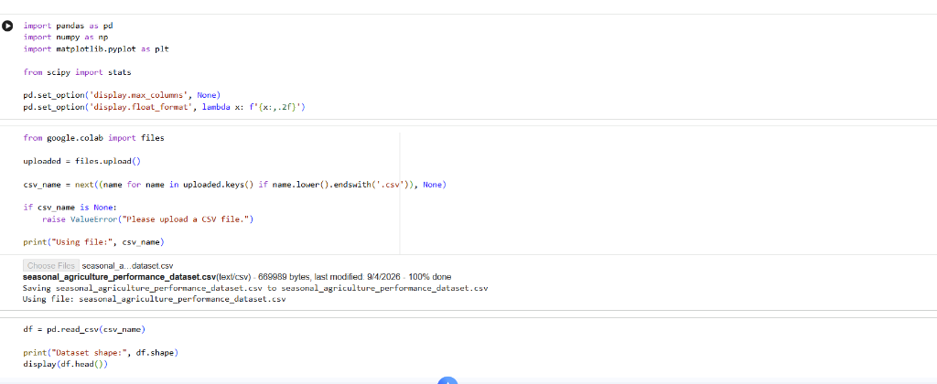
Results

Slide 7
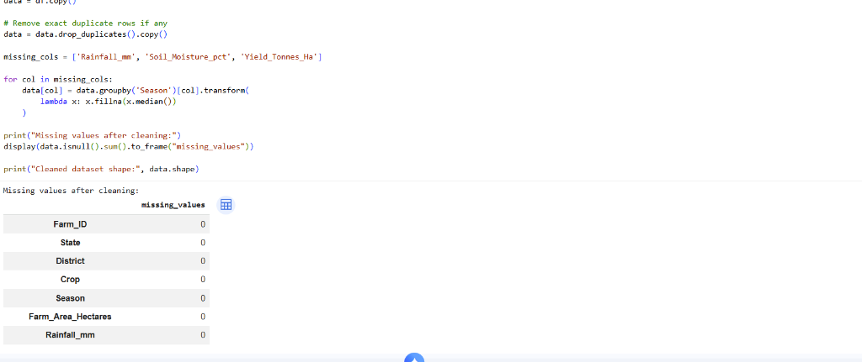
Results

Slide 8
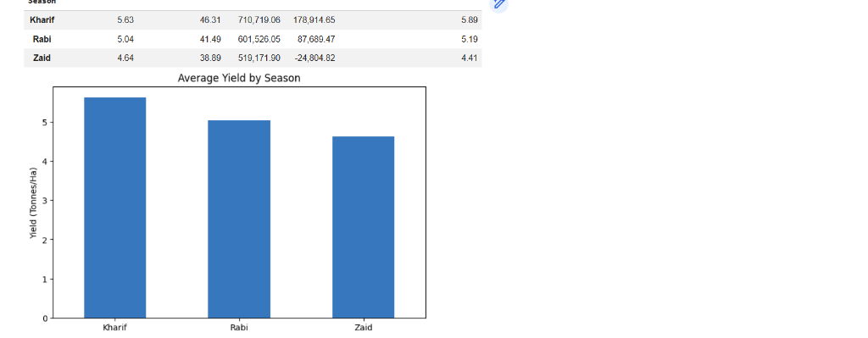
Results

Slide 9
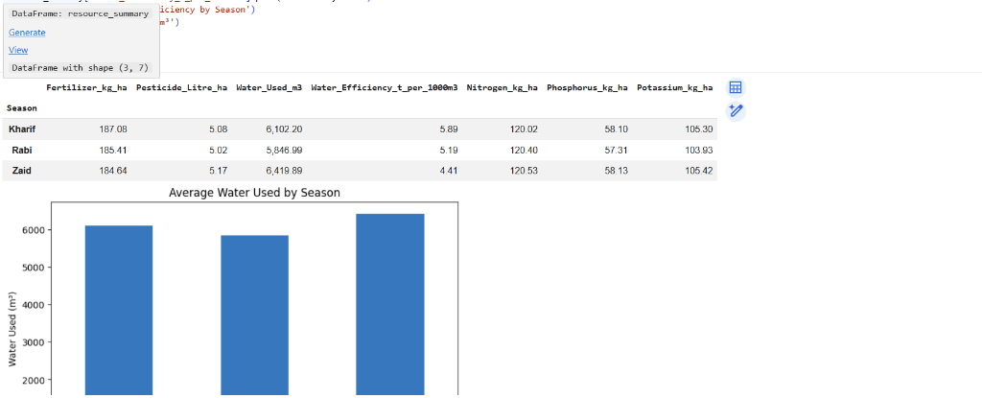
Results

Slide 10
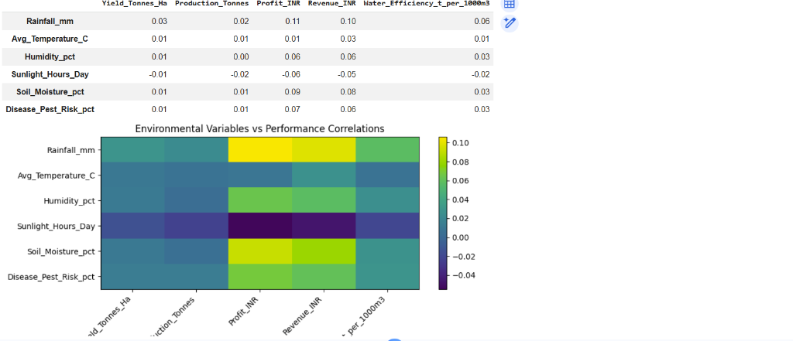
Results

Slide 11
Future scope
Predictive Yield Modeling (Machine Learning): Build regression and ensemble models (e.g., Random Forest, XGBoost) to predict farm yield and net profit based on early-season climate forecasts and soil parameters.
Integration with Live Remote Sensing Data: Incorporate satellite imagery (e.g., NDVI indices) and real-time weather APIs to monitor crop health and disease/pest risks continuously across seasons.
Climate Change Impact & Scenario Analysis: Simulate long-term climate scenarios (e.g., rising average temperatures, erratic rainfall) to stress-test seasonal resilience and evaluate future agricultural risk.
Dynamic Crop Recommendation System: Create an AI-driven advisor that suggests optimal crop choices per season and region based on real-time market prices, historical profitability, and weather predictions.
Precision & Micro-Irrigation Optimization: Develop real-time water scheduling algorithms for the dry Zaid season using soil moisture sensors and drip/sprinkler irrigation efficiency data.

Slide 12
GitHub Link
https://github.com/Ganesh50-ui/Seasonal-Agriculture-Performance/blob/main/Untitled8.ipynb

Slide 13

VOIS Course completion certificate - Course name- Data Visualization

Slide 14
Thank you
.
.

